Slide 1

State of Idaho
Classification & Compensation 101
Presented by: Idaho Division of Human Resources
Date: October 20, 2021

Slide 2
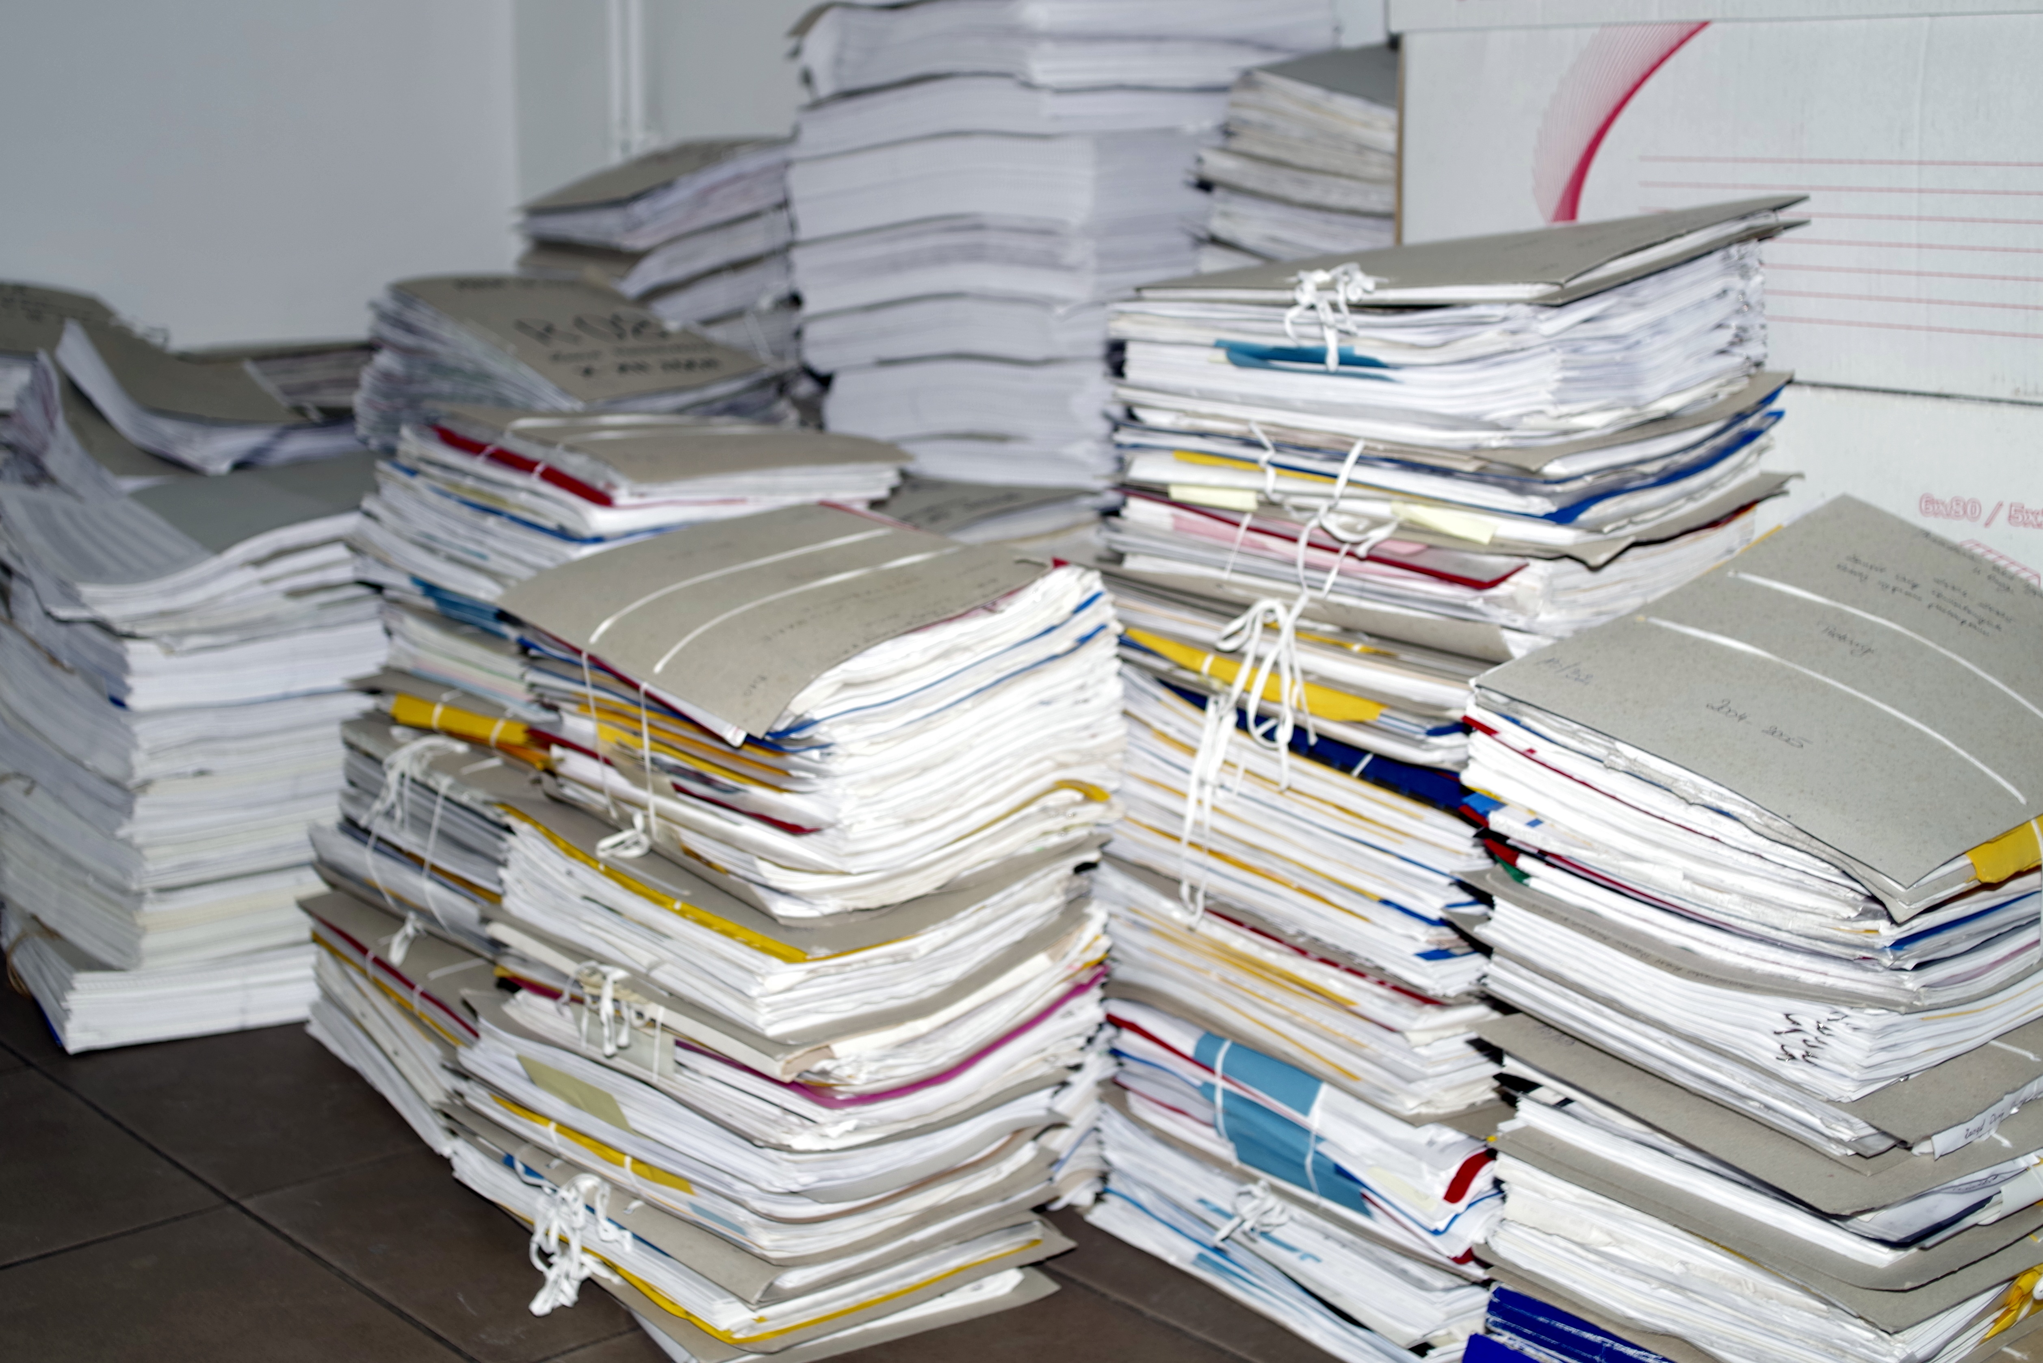
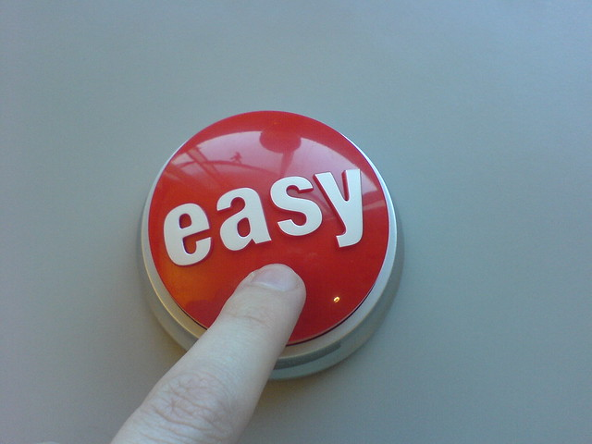
Agenda/Goals
Classification overview
Compensation overview
Tools for Success
New Forms to assist you
This Photo by Unknown Author is licensed under CC BY-NC-ND
Notes:
We are going to focus on how to use classification and compensation to do the things you need to do in your agency.
30,000 foot view of classification and compensation.
What items are truly classification related – and what things can you accomplish from a compensation point of view – utilizing current statutes, rules and policies.
We have some new forms that will streamline the process.

Slide 3





Roles & Responsibilities
Agency/Board
Division of Human Resources
Division of Financial Management
Governor
Legislature​
Division of Human Resources (DHR) Roles & Responsibilities
Administer the state personnel system, promote operational excellence by encouraging collaboration and efficiencies among State agencies to recruit, develop, and retain a proficient and diverse workforce. (Idaho Code Section 67-5301)
Uphold DHR statutory and rule requirements (Idaho Code Section 67-5308, 5309, /IDAPA 15.04.01.000 )
Provide administrative and financial support to the Idaho Personnel Commission (IDAPA 15.04.01.009)
Notes:
First, let’s talk about all those who can be involved in classification and compensation recommendations and decisions.
This is not quite a linear process, but most requests will originate within your agency – from a board recommendation – supervisor/management need, etc.
These are all the players involved in the decision-making process when it comes to classification and compensation.
Not every decision moves through each of these roles, so we hope to give you an overview of what and when…
Delegated and non-delegated agencies
DHR’s role in class & comp is setting up overall structure using statute, rule and policy.
Reviewing requests that come in. We’re just looking at it from that perspective. Our role is to help the agency.

Slide 4
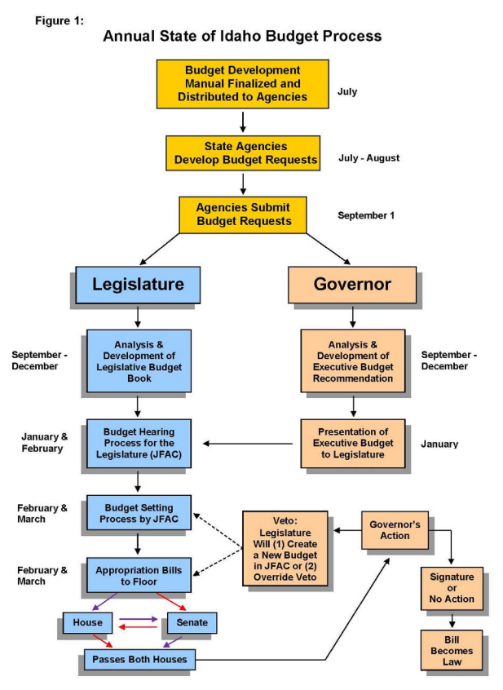
Notes:
A visual layout of how a Budget Request for staffing moves through the process.
If you have requested new positions for the FY 2023, you are “here” in the process. This was the first year of the DHR attestation – so for some of you, you just had your positions “classified” at the front end – so that when/if your request if approved through the legislature – you can move forward with recruitment swiftly.

Slide 5
True or false
What should you do?
False
1. You should use reclassification as a tool to get someone more money.
2. I don’t see an exact match in classification for the position we are hiring. We need to create one from scratch.
3. When completing a PDQ, you should copy & paste a class spec into a PDQ..
4. A job description and a class spec are not the same thing.
False
False
True

Slide 6


Slide 7

classifications
The work required for jobs are defined in State job classifications and agency specific job descriptions.
Classification – the designation given to a group of positions performing similar work that are in the same pay grade. (Idaho Code Section 67-5309(a))
Appropriate position classification provides the foundation for equal pay for equal work, identification of actual work performed, fair employment, equal opportunity for promotions and equitable compensation. (IDAPA 15.04.01.068)
This Photo by Unknown Author is licensed under CC BY
Notes:
Classification is the work that is done before compensation.
We can’t pay a job appropriately unless we know what it does.
Why?
Employee knows what to do
Essential functions
Ensure Legal Compliance (like FLSA & ADA)
Career Path (what comes next?)
Training opportunities
Performance evaluations
Equitable compensation system (when done right)
Over 50% of our requests that come into DHR are for some type of class or comp issue

Slide 8
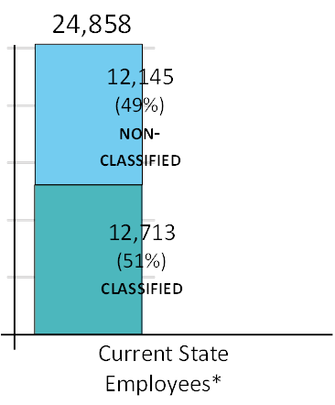
Classification overview
Classified Employees
Non-Classified Employees
Current State Employees
All employees are classified unless specifically exempted in code. (Idaho Code Section 67-5303)
Subject to the provisions of the merit exam, selection, retention, promotion and dismissal requirements (due process) of Idaho Code, Title 67, Chapter 53​
Approximately 12,713 classified employees​
Exempt from Idaho Code, Title 67, Chapter 53, but subject to Idaho Code, title 59, Chapter 16
Required to be paid a salary comparable to classified positions with similar duties, responsibilities, training, and experience.
Additional non-classified positions may be defined in agency specific statutes
Approximately 12,145 non-classified employees
Notes:
Whether a position is classified or non-classified, we still need to define the work being done (that’s through classifications and agency specific job descriptions)
Evaluate the level and impact of that work, and
place a value on the work (which we will get into during compensation)
Why classify positions? So we can hire appropriately, ensure existing employees are in the correct classification, and provide for opportunities to promote.
Note: in anticipation of LUMA – we are attempting to standardize classifications and will do our best to treat positions similarly – whether they are classified or not. We will be shoring up our process around this. So, you may be asked to provide job descriptions or PDQs as appropriate – as we venture down the path of standardization.
Why & How to use the classification system:
Defining the work
Evaluating the work
Pricing the work
Hiring a new position
Reclassify an existing position
Promotional opportunities

Slide 9
Classification process
Class specs
Job description
Job evaluation
HR Review
decision
Active class specs for classified staff
Similar/comparable for non-classified staff
Minimum Qualifications
What does the position actually do?
Why does it exist?
Who does it impact?
Essential Functions
Aka job analysis
Interviews
PDQ
PRS
PAF
Org Charts
Supv/Mgr input
Agency review or DHR level review depending on delegated or non-delegated status
Communication
IPOPS action
Employee notification
Notes:
There are several elements that go into the classification process This is the process of how a position (whether new for recruitment or existing to determine classification) moves through the process.
Here are the tools that are used in order to make classification decisions.
PDQ, PRS, PAF form – we are going to simplify this process…new simple
Note: if you are attempting to classify a position, but do not see an exact match in classification specs, we utilize at least 80% “match” based on the whole-position analysis. In most cases, there is no need to create a whole new classification; you can use an existing classification.
Class Specs should be changing. The Job Desc – should be revisited and updated annually (during the perf eval cycle).
For reclasses: DO NOT notify the employee until the reclass has been approved. A reclass does not always equate to a pay increase.

Slide 10
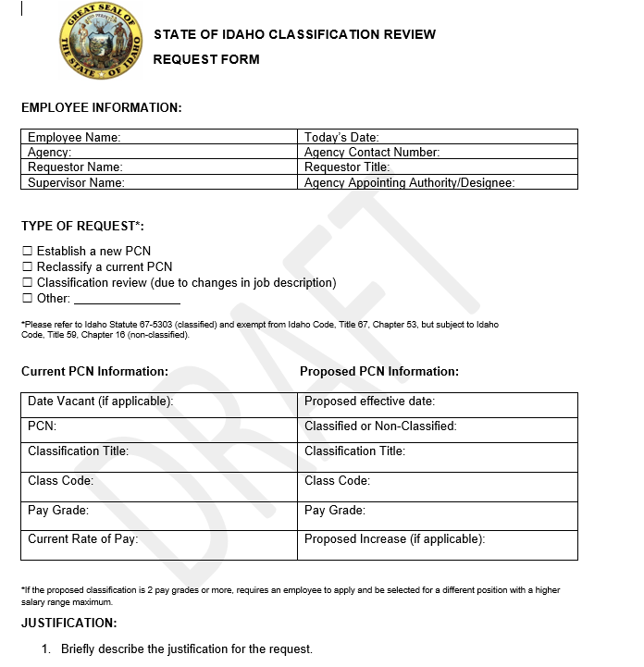
New classification
Form

Slide 11
TRUE or false
What should you do?
False
1. Reclassifying an employee upward always comes with an increase.
2. Increasing the compensation for a non-classified employee does not need to be approved by DHR.
3. Susie has been doing an amazing job in her work. She does all of her tasks on time and with a smile. This is a good case for an equity increase.
4. A recruitment bonus is a strategy to employ when attempting to attract more candidates.
False
False
True

Slide 12

compensation
.
Compensation – the money received by an employee from an employer as a salary or wages. The State of Idaho provides a competitive merit-based compensation structure to attract qualified applicants to the state workforce; retain employees who have a commitment to public service excellence; motivate employees to maintain high standards of productivity; and reward employees for outstanding performance
The connection between classification and compensation is the pay grade. Once the work has been identified, then appropriate compensation can be determined by pay grade assignment.
Funding must be approved by DFM & DHR (Idaho Code Section 67-3501)
The Hay Method uses the concepts of Know How, Problem Solving and Accountability value how the goals of the organization are met and the requirements of the jobs to meet them.
Notes:
There are many forms of compensation – as in total comp, but for purposes of this training – we will focus on compensation as it relates to money/pay.
The state uses the Hay Group methodology to evaluate our jobs because it works to design efficient and consistent job and organization structures to fit people into their jobs while being able to track performance efficiently. The Hay method is timeless in that the concepts of Know How, Problem Solving and Accountability value how the goals of the organization are met and the requirements of the jobs to meet them in order to assign the appropriate pay grade.

Slide 13
compensation overview
Determining Pay
Things to Consider
Salary offered may be anywhere within the pay range of the classification (IDAPA 15.04.01.072.01)
Available Funding
Compa-ratio
Statewide Policy
Agency Policy
Experience
Performance
Internal Equity
External Market Factors
Salary Compression
Qualifications of Candidate
Candidate Pool
Current Labor Market
Notes:
Compa-ratio
The relationship between an employee’s salary and the policy pay rate (market) of their job
Hourly Rate/Policy Rate
Internal equity
Comparison of pay for similar positions, level of performance, and years of service in the position
Salary compression
When the pay rates of several employees, despite clear differences in capability, are clustered close together
For example: newly hired incumbents are being paid more than experienced incumbents for the same job

Slide 14
Compensation policy
Permanent merit increase (CEC)
Permanent equity adjustment increase
Temporary merit pay increase
Payline exceptions/moves
bonuses
As determined and approved by the legislature
Based on performance
At least APS
Evaluated on annual basis
Internal/external market factors
Correct inequities
Compression issues
Not appropriate for workload increase or longevity
Short-term, non-permanent increase to employee base pay
Recognize for short-term work assignments
Up to 6 months
Higher temporary pay grade granted by exception
Movement of the pay schedule by the legislature
Performance (20% limit)
Recruitment
Retention
Suggestion Bonus
Notes:
Exceptional pay increases can be permanent or temporary – depending on the reason for the increase
Here are the types of increases – taken directly from the Statewide Compensation Policy
Note: Bonuses – are one-time
Movement within a pay grade
Merit Increase (ongoing)
Short Term Merit (temporary)
Bonus (one time, $2,000 limit per fiscal year unless approved in advance by Board of Examiners)
CEC (As determined/approved by legislature)
Internal Salary Equity Adjustment (ongoing - approved by DHR)
Based on performance (Idaho Code Section 67-5309B)
Suggestion/Recommendation Bonus (one time)
Based on an employee’s idea to save tax-payer dollars
Limited to 25% of the savings realized or up to $2,000 (Idaho Code Section 59-1603(8) and 67-5309D(2)) Above $2,000 may be approved in advance by the State Board of Examiners.
Recruitment/Retention Bonus (one time)
Complete at least 6 months of achieving performance standards (Idaho Code Section 59-1603(11) and 67-5309D(3))
Employee signs memorandum of understanding
Payline Exception
Higher temporary pay grade granted to a classification in order to obtain or retain qualified staff. Must be approved by DHR administrator and reviewed annually. (Idaho Code Section 67-5309D(6))
Funding must be approved by DFM (Idaho Code Section 67-3501)

Slide 15
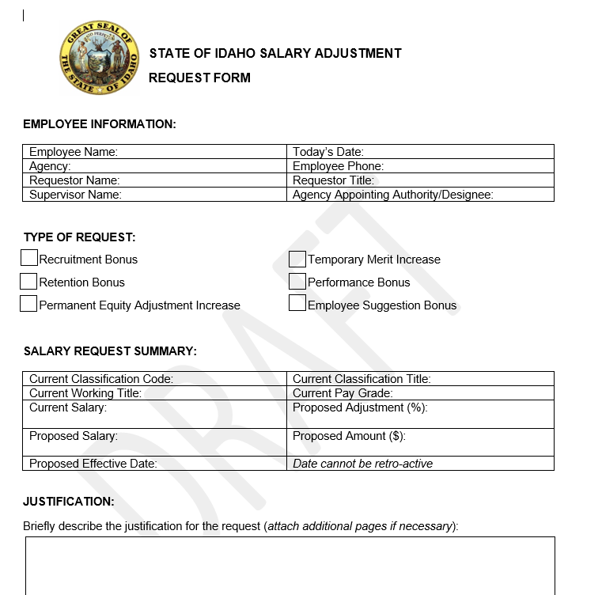
NEW SALARY ADJUSTMENT
Form

Slide 16

“You cannot mandate productivity. You must provide the tools to let people become their best.”
Steve Jobs

Slide 17

Questions?
DHR Policy Bureau
Janelle White, Bureau Chief
janelle.white@dhr.idaho.gov
Hannah Lopez, HR Specialist, Sr.
hannah.lopez@dhr.idaho.gov
Haley Westenskow, HR Specialist, Sr.
haley.westenskow@dhr.idaho.gov
Chrystelle Zimmerman, HR Specialist, Sr.
chrystelle.zimmerman@dhr.idaho.gov

