Slide 1


DHR Employee Complaint Line
THE VALUE OF AN HR HOTLINE

Slide 2


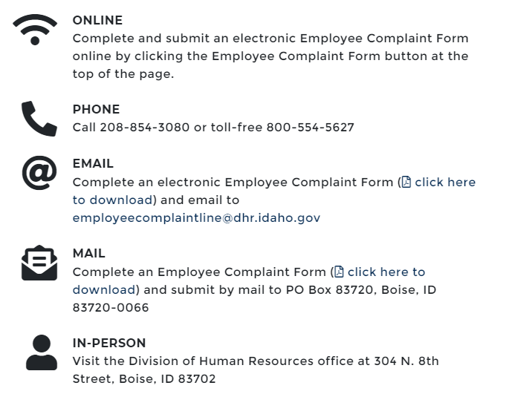
INTAKE

Slide 3
ASSESSMENT
Immediate danger or threat
Priority
Who is responsible for next steps
Patterns or repeat complaints

Slide 4
AGENCY OR DHR?
DHR works in partnership with agencies to resolve complaints.
More than half have been assigned to the agency to do follow-up with the employee and report back.
Less than 10 are being investigated solely by DHR.
The remainder are a collaboration between the agency and DHR.

Slide 5
INVESTIGATE
When a DHR Consultant contacts you, we will include:
Complainant’s Information
Accused’s Information
Incident details

Slide 6

DEFINITIONS

Slide 7
FRAUD:
The intentional deception and representation by a person which could result in a benefit to them, others or the State or could cause detriment to others or the State.
WASTE:
The intentional or unintentional, thoughtless or careless expenditure, consumption, mismanagement, use or squandering of State resources to the detriment or potential detriment of the State.
ABUSE:
Excessive, or improper use or violation of a thing or policy, or employment of something in a manner contrary to the natural or legal rules for its use. Intentional destruction, diversion, manipulation, misapplication, mistreatment or misuse of State resources.
DISCRIMINATION/HARRASSMENT:
Employment discrimination based on race, color, gender including sexual harassment, age, veteran status, national origin, religion, political affiliation or disability.

Slide 8
DATA
Employee Complaint Line went live July 1, 2020.
As of November 10, 2020, 73 complaints have been filed.
Of the complaints received:
29 were categorized as “abuse of power”
18 were categorized as “discrimination”
6 were categorized as “fraud”
12 were categorized as “harassment”
8 were categorized as “waste”
44 complaints have been closed; 29 remain active.

Slide 9
EXAMPLE ALLEGATIONS
Note: These are example allegations, not findings.
Fraud:
Utilizing agency resources for personal gain
Selling government purchased materials
Waste:
Continuous office moves
Stealing supplies
Abuse of Power:
Concerns over agency leadership and/or HR
Wrongful termination
Questioning agency policy and decisions
Dissatisfaction with shift and schedule change

Slide 10
EXAMPLE ALLEGATIONS, cont.
Note: These are example allegations, not findings.
Harassment/Discrimination:
By agency leadership
Hostile coworkers
Improper discipline
Promotional practices
Based on a protected class
Mishandling an investigation

Slide 11
COVID-19 RELATED
12 out of 73 specifically related to COVID-19:
Lack of concern from leadership due to COVID-19
Alleged mishandling of COVID-19 policies
Not taking appropriate COVID-19 precautions
Not abiding by CDC guidance
Disciplinary action related to having COVID-19

Slide 12
CONFIDENTIALITY EXPECTATIONS
Individuals who are making complaints often desire confidentiality and/or complete anonymity in the process. Complainant confidentiality expectations are as follows:
HR cannot maintain complete confidentiality with any complaint.
There are certain complaints that we are required to investigate.
When an employee files a complaint, DHR will only share information regarding the complaint on a need-to-know-basis and only the minimal information necessary to review/investigate the complaint.
DHR will take steps to maintain the identify of the person who filed the complaint.
Other complaints that do not allege illegal activity and do not necessarily require any DHR action, such as complaints about not getting along with a coworker, disliking a manager’s leadership style, etc. can be brought to DHR and we can provide options for resolution (i.e., having a Crucial Conversation, filling for problem solving, etc.).

Slide 13
VALUE OF AN EMPLOYEE HOTLINE

Slide 14
MAKE IT ABOUT CULTURE
Hotlines promote an ethical culture by offering employees a convenient, anonymous way to report wrongdoing through:
Training and awareness
Ongoing communication
Accessibility
Transparency
Proficiency and objectivity
Assessment

Slide 15
WHAT MAKES A HOTLINE TRUSTED?
Convenient
Anonymity
Reinforce ethical culture
Employee pride
Educate

Slide 16
ADVANTAGES TO HR
Awareness
Confidentiality
Trust
Unbiased recommendations
Consistency
Employer protection

Slide 17
RETALIATION PROTECTION
Individuals who file complaints with the DHR Employee Complaint Line and/or participate in an investigation/fact gathering related to a complaint, are protected against retaliation by the Idaho Public Employee Protection Act (IPPEA) – Title 6, Chapter 2104
According to the EEOC, retaliation occurs when an employer takes a materially adverse action because an applicant or employee asserts rights protected by the EEO laws. Asserting EEO rights is called "protected activity.“
Sometimes there is retaliation before any "protected activity" occurs.

Slide 18
QUESTIONS? CONTACT US
Ashleigh Lopez, Training and Communications Bureau Chief
(208) 854 - 3057 ashleigh.lopez@dhr.Idaho.gov
Racheal Hall, HR Associate
(208) 854 – 3039 racheal.hall@dhr.Idaho.gov
Michelle Peugh, DHR Strategic Business Partner
(208) 854 - 3073 michelle.peugh@dhr.Idaho.gov
Le Ann Stephens, DHR Strategic Business Partner
(208) 854 - 3077 leann.stephens@dhr.Idaho.gov

