Slide 1
Culture & Values
Establishing the foundation for change
DHR Forum November 17, 2020
Notes:
Thank you so much for allowing me to speak to DHR.
I am Patti Perkins, Director of the Department of Finance. I just started with the agency in January of this year. What a year to start a new job!
You may wonder why on earth a Director of this agency is speaking to a group of HR professionals about Culture & Values!? Well, I have over three decades of experience in both commercial banking AND HR. Prior to coming to the State, I worked in my own HR consulting business, which I still have, though I no longer actively consult.

Slide 2
Elements of Culture
VISION
MISSION
VALUES
Notes:
Susan Buxton and LeAnn Stephens asked if I would share with you the process I used in our agency to determine a set of Values.
I was very surprised when I realized there was no articulated set of values in our Department. One of the upsides of COVID was the change in external meetings which allowed me to focus internally.
There are three main elements of culture – Vision, Mission and Values.

Slide 3
Vision
The organization’s aspiration
A statement given by an organization saying what they intend to become or achieve
Usually stated in one sentence or fragment
Sums up where the organization wants to be in 10, 20 years or longer
Is broadly stated
Inspirational
This Photo by Unknown Author is licensed under CC BY-SA-NC
Notes:
Most of you have been through exercises and know what these elements are, but as a refresher, the definition of Vision is….

Slide 4
Mission Statement
Short statement of why an organization exists
Statement of the organization’s overall goal
Identifies the goal of its operations: what kind of product or service it provides, its primary customers or market, and its geographical region of operation
May include a short statement of the organization's values or philosophies, a business's main competitive advantages, or a desired future state—the "vision"
Notes:
A Mission Statement, critical to the organization, is:

Slide 5
Values
A set of words, concepts, character traits, or phrases that describe the philosophies and beliefs
Guides decision-making
Identifies desired behaviors
Provides for common language
Helps define expectations internally and externally
Notes:
And the third element of Values is:

Slide 6
Organizations Need All Three
Vision, Mission and Values work together to describe and articulate the organization’s culture
Defined as:
How we do things around here

Slide 7
CULTURE
Culture exists in every organization
Made up of practices, beliefs, philosophies and processes
Exists whether the organization wants it to or not
Should be intentionally developed, but often just happens
Notes:
Culture – should be intentional

Slide 8
Discussion
Name THREE WORDS that describe your agency’s CURRENT CULTURE.
How do we do things around here?
How do we treat people?
Is this how we want the culture to be defined in the future?
Notes:
This is what I asked my time:
Do you want to try it? What three words describe the current culture of DHR? You want to think about these three questions.

Slide 9
What VALUES support our CULTURE?
Notes:
Then, I asked the team to identify what values supported our culture.
I wrote them on a flipchart

Slide 10
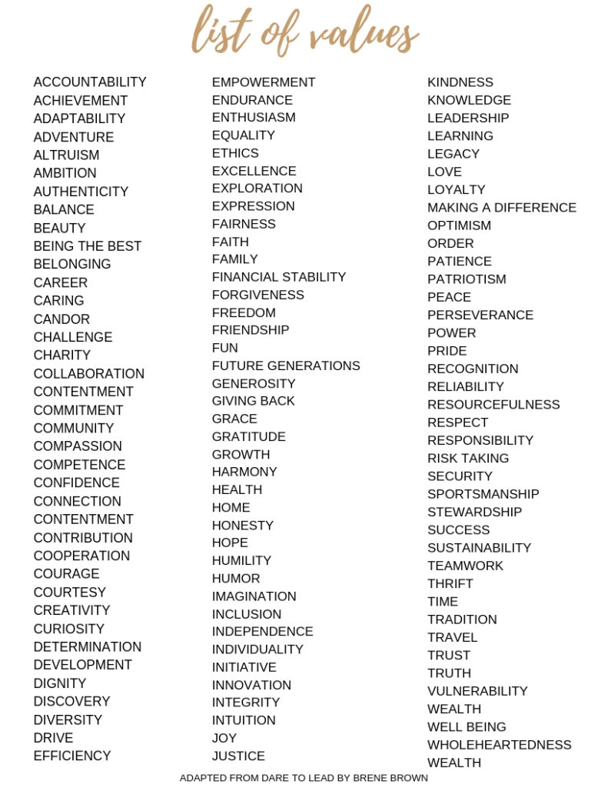
Notes:
You’ve heard of Brene Brown, I’m sure….thought leader and author in leadership, TED talk-er on vulnerability and other things.
This list comes from one of her books, Dare to Lead. It is a list of values, though not all inclusive. In fact, I noted early on that “communication” is missing. But this is a great started list for people.

Slide 11
Sample Exercise Brainstorming 15 minutes
In groups of 2-3 (appropriately socially distanced of course)
Brainstorm your top 3 VALUES that you would like to see your agency adopt
Create a short definition (you can elaborate verbally)
Report out by group

Slide 12
Questions to Consider
What is important to us?
What brings us all together and continues to hold us together?
What will help guide us when we are facing a difficult decision?
What are the things we LIKE about what we do at our agency and how we do it?
What parts of our agency are we proud of?
REFINING OUR IDEAS
Is this something we’ll still believe in 5 years? 10 years?
Are we willing to hire on these values?
Are we willing to separate people based on these values?
Are these as applicable to our external relationships as they are to our internal relationships?

Slide 13
Debriefing the report out
On a flipchart (or whiteboard) capture the values the groups suggest
When all the groups have completed, ask each member of the team to vote for their top five or six values
The votes can be identified by giving the team members dot stickers for them to place by the values they choose
Identify the values that have the most votes
Validate the group chooses the values with the highest votes
Review the “Questions to Consider” slide in light of the selections
Determine how the values will be DEFINED – separate workshop or allow leader to define and get feedback later

Slide 14
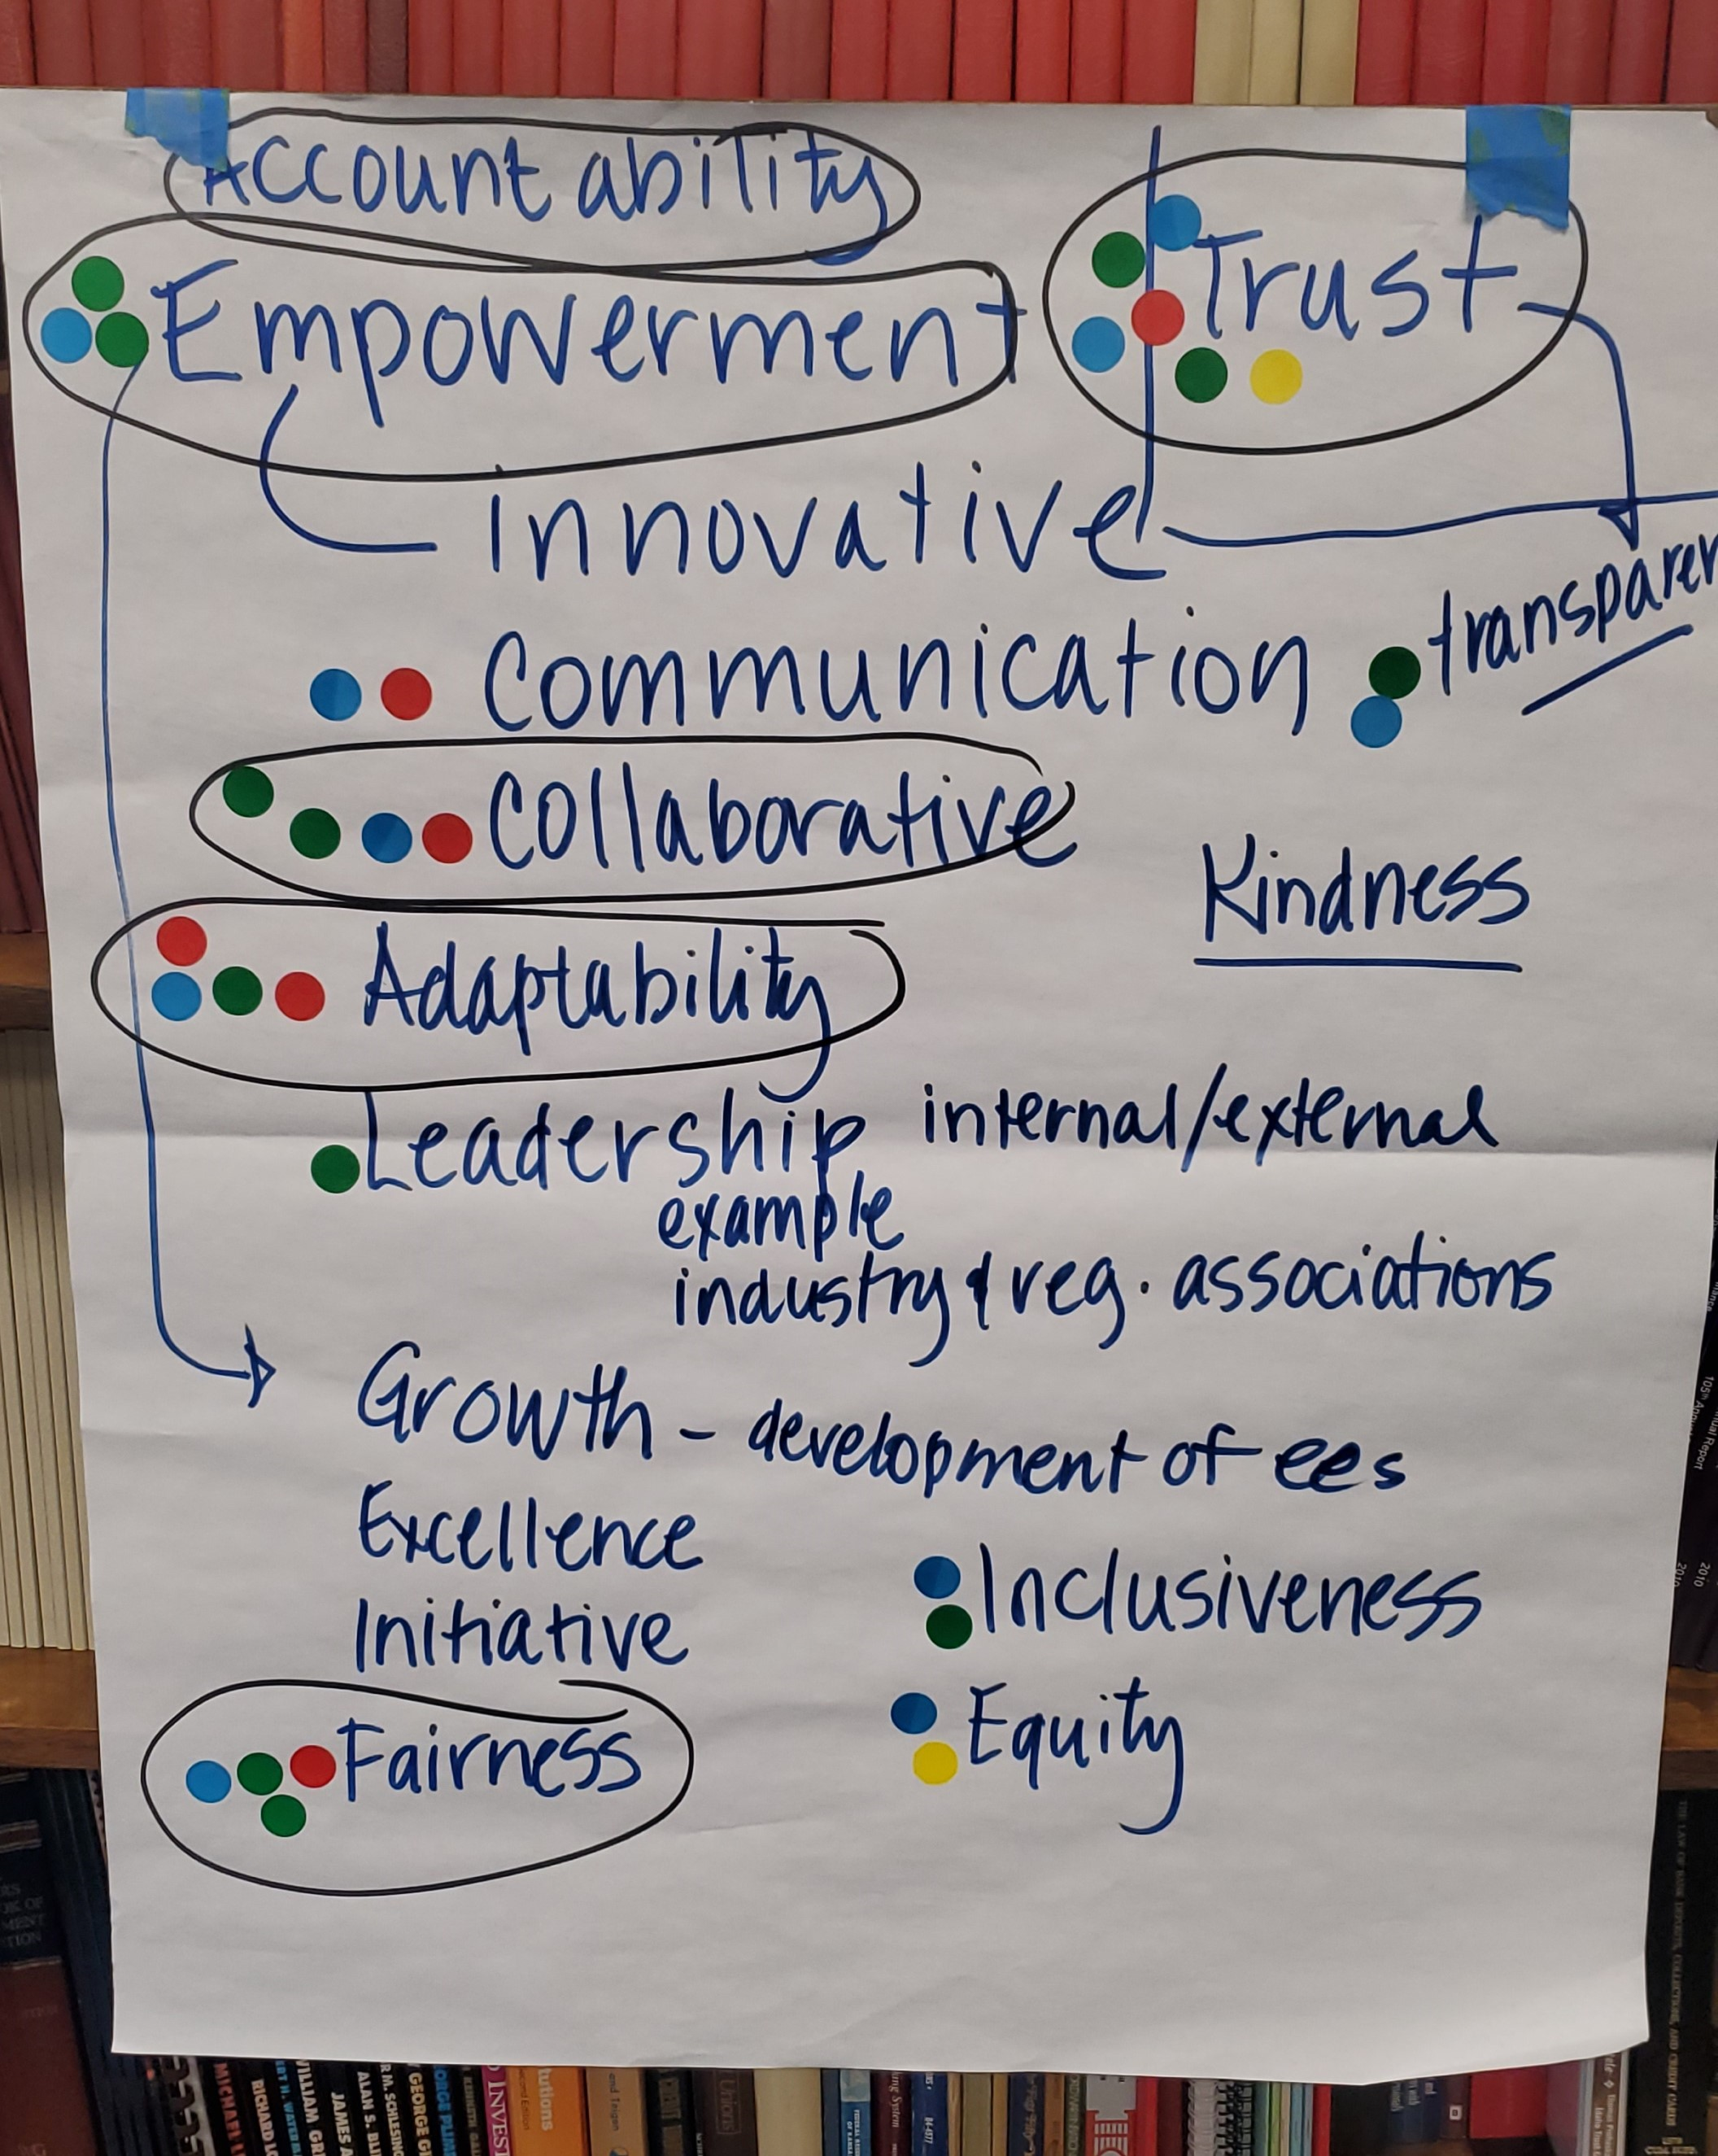
Notes:
Here is how our flipchart ended up.

Slide 15
Next Steps
Leader to provide you with the initial set of values selected and their definitions
Review and edit
Leader will edit the draft and send back to you
Meet with your direct reports and review values with them.
What do they think?
Can they live with these?
Do they understand and/or relate to them and the definitions?
Are we missing anything?
Provide Leader edits – SLT to meet again to consider edits
Finalize values and send out as a DRAFT to employees for their input
Collect input, edit as needed and ROLL OUT the new Values.
Sample Process

Slide 16
Future Use of Values
We want Values to be part of what we do every day
They must be integrated into our language around performance, relationships and decisions
They must be aligned to what we say and do with performance management and performance appraisals
Create ways to help employees know and remember values
Posters
Laminated cards
Other?

Slide 17
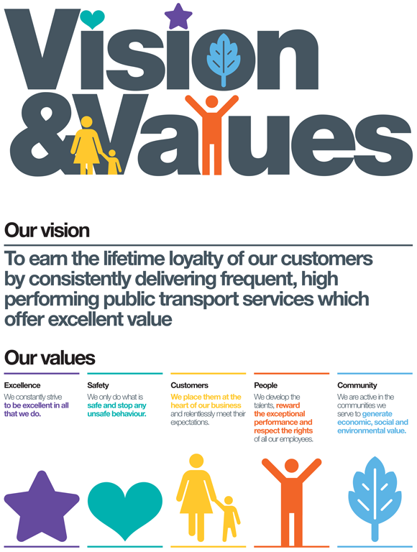

Slide 18
Values Definitions – IDOF
TRUST -- Trust means that we do what we say we will do and are transparent in our communication. We are ethical and act with honesty and integrity. We consider the impact on all our stakeholders before acting and making decisions. [Our stakeholders are staff members, entities regulated/licensed, industry associations, Idaho citizens, the Governor’s office and our Legislators]. Trust means that we will assume positive intent in our interactions with our staff members and other stakeholders.
ACCOUNTABILITY -- Accountability is both individual and corporate. It means that as an individual, I own my decisions, actions, behavior and work performance. I do what I say I will do and follow through. I am responsible for my individual development and work product. I show up on time, I participate, and I contribute to the mission of the Department. I will initiate or request professional development as needed. I will provide constructive feedback to others and will accept and act upon it when delivered to me. I will not make excuses but will work hard to deliver promised results. As leaders, we are responsible for what goes on in the teams that we manage. As team members, we hold others and ourselves accountable to the standards and values of the Department.
EMPOWERMENT -- We will prepare our employees to do their jobs and get out of their way so they can do them. We will listen to everyone’s suggestions and ideas for different ways of doing things. We will provide educational opportunities for growth and development. Our staff members have a voice in what we do in the Department.
COLLABORATIVE -- We work together to get the best ideas, processes and results. We are not in competition with one another but know that we each bring unique skills and insights to a project. Because of this, we want to hear from everyone. Collaboration creates a better outcome when we are open to consider new ideas and ways of thinking. We make decisions about the Department direction and policies with input from multiple sources to ensure we consider issues from many sides. Collaboration fosters innovation and inclusiveness. We collaborate internally and with external stakeholders and partners.
ADAPTABILITY -- The Department is adaptable to the changing landscape of financial services. We are responsive and adaptive to change as it influences the nature of the industries we oversee. We strive to be forward thinking and flexible while balancing the need for fairness and accurately assessing a situation or set of facts.
FAIRNESS -- We strive to be fair to one another and in our decisions, both internally and externally. We understand we cannot always have an equal outcome but work toward equitable results that are balanced and support the values of the department. We will be civil and kind in our interactions with all stakeholders.

Slide 20
QUESTIONS

