Slide 1
Idaho Labor Market Information
Idaho Labor Market Information
Presenter, Title
Presenter 2, Title or Date
Fall 2021 DHR Forum
Oct 20, 2021

Slide 2
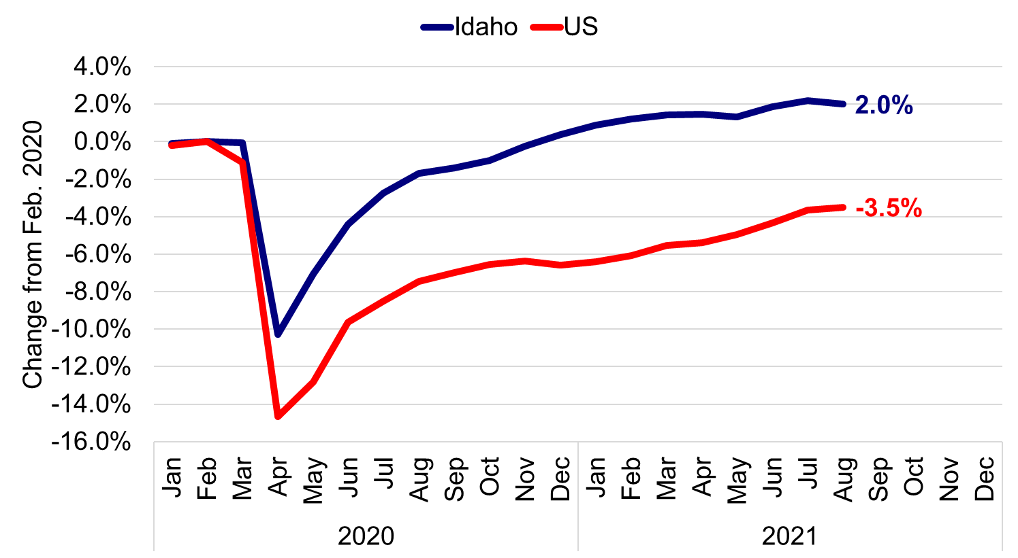
Total Nonfarm Jobs Change from Feb. 2020 to Aug. 2021
Source: Idaho Department of Labor

Slide 3
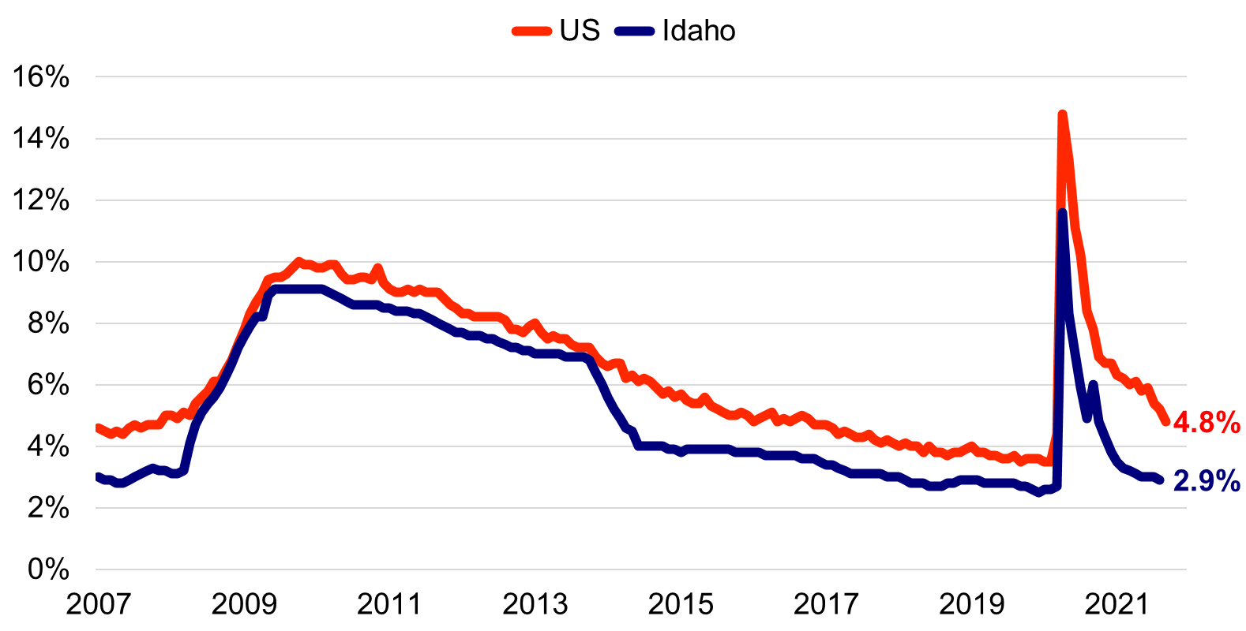
Unemployment Rate Jan. 2019 to Aug. 2021
Source: Idaho Department of Labor

Slide 4
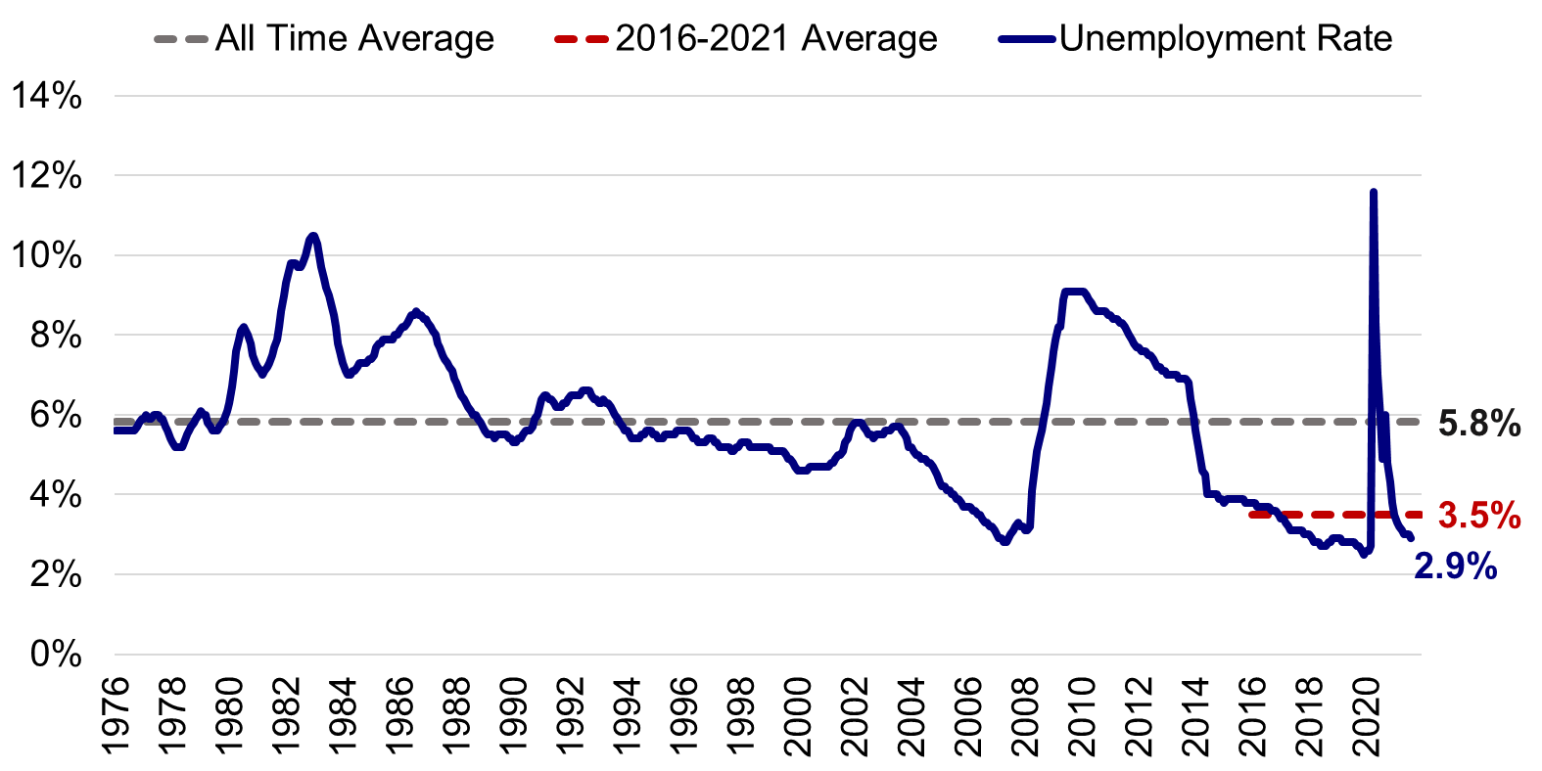
Idaho Unemployment Rates Compared with Annual averages: 1978 to 2020, 2015 to Aug 2021
Source: Idaho Department of Labor

Slide 5
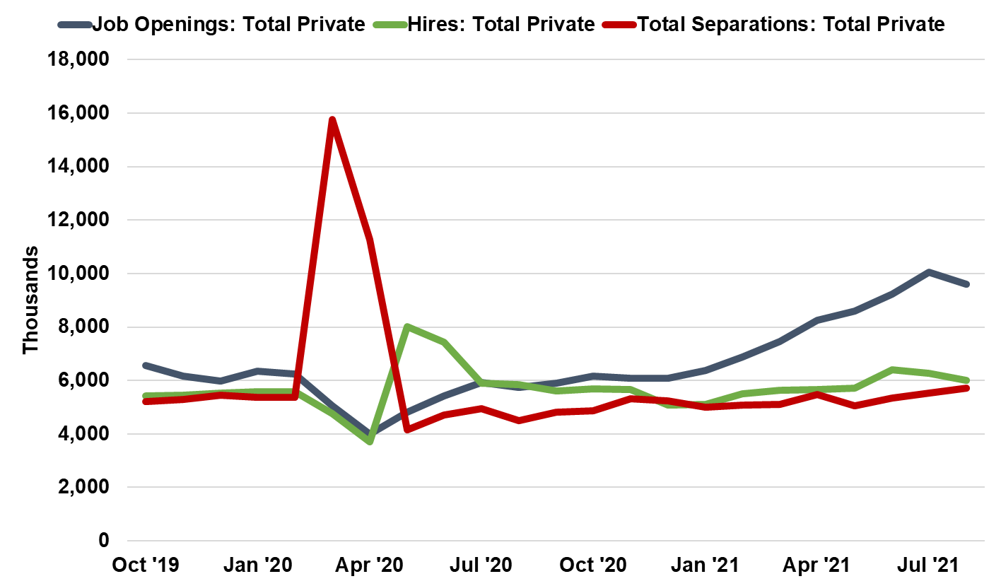
Job Openings, Hires, and Separations Nation, Oct. 2019 to Aug. 2021
Source: Idaho Department of Labor, Bureau of Labor Statistics

Slide 6
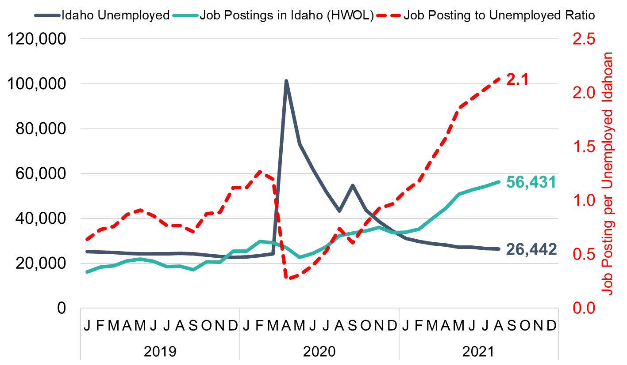
Idaho Job Openings and Unemployed Compared Jan. 2019 to Aug. 2021
Source: Idaho Department of Labor, Bureau of Labor Statistics

Slide 7
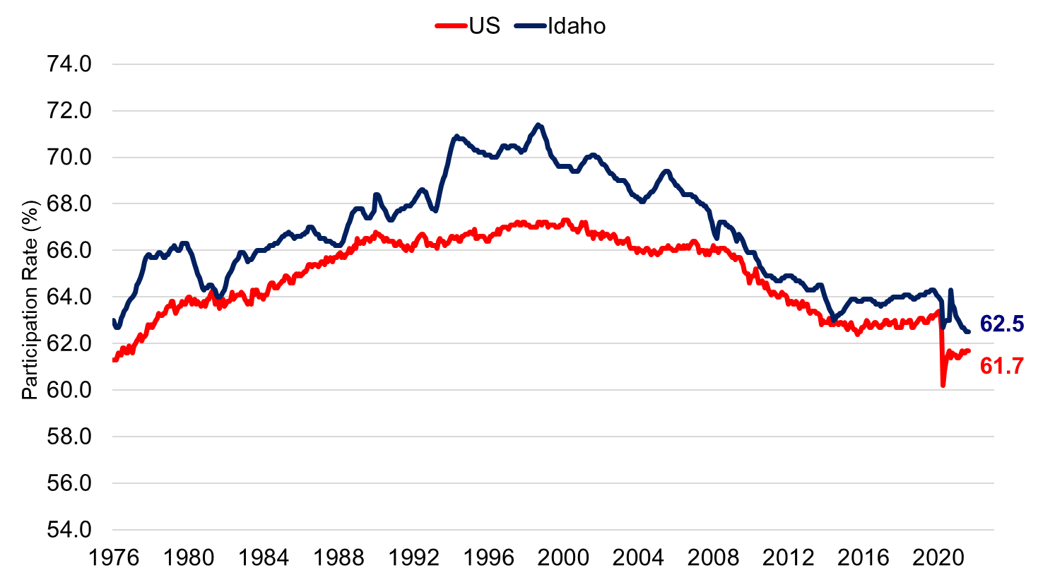
Labor Force Participation Rate Change from Jan.1976 to Aug. 2021
Source: Idaho Department of Labor

Slide 8
The Labor Force
■ Civilian Population ■ Labor Force ■ Employment
Source: Idaho Department of Labor

Slide 9
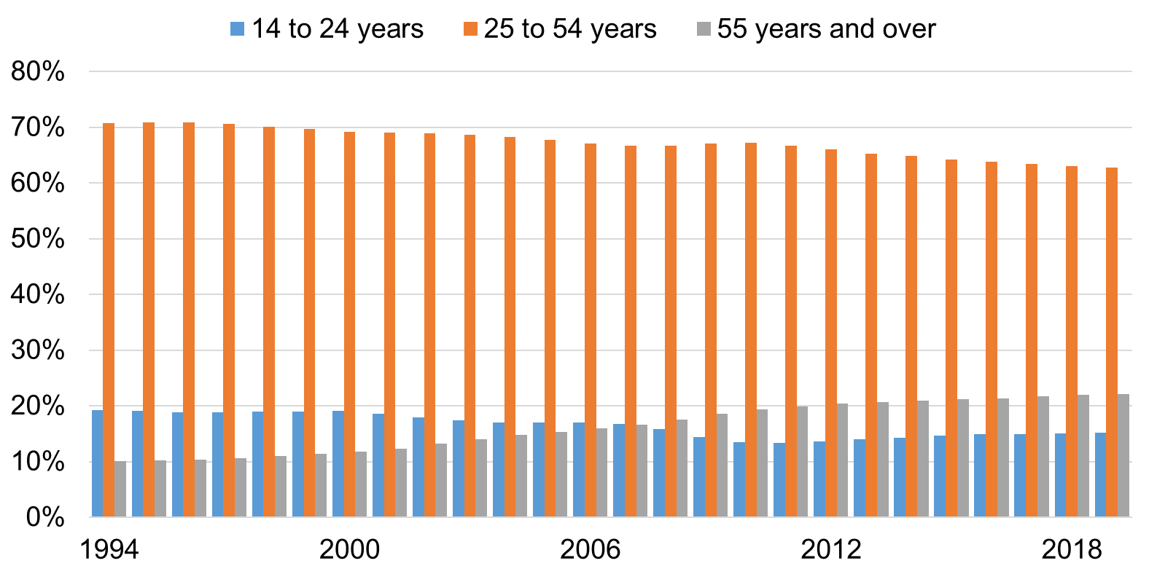
Percent of Covered Workers in Idaho by Age, 1994 - 2019
Source: Idaho Department of Labor

Slide 10
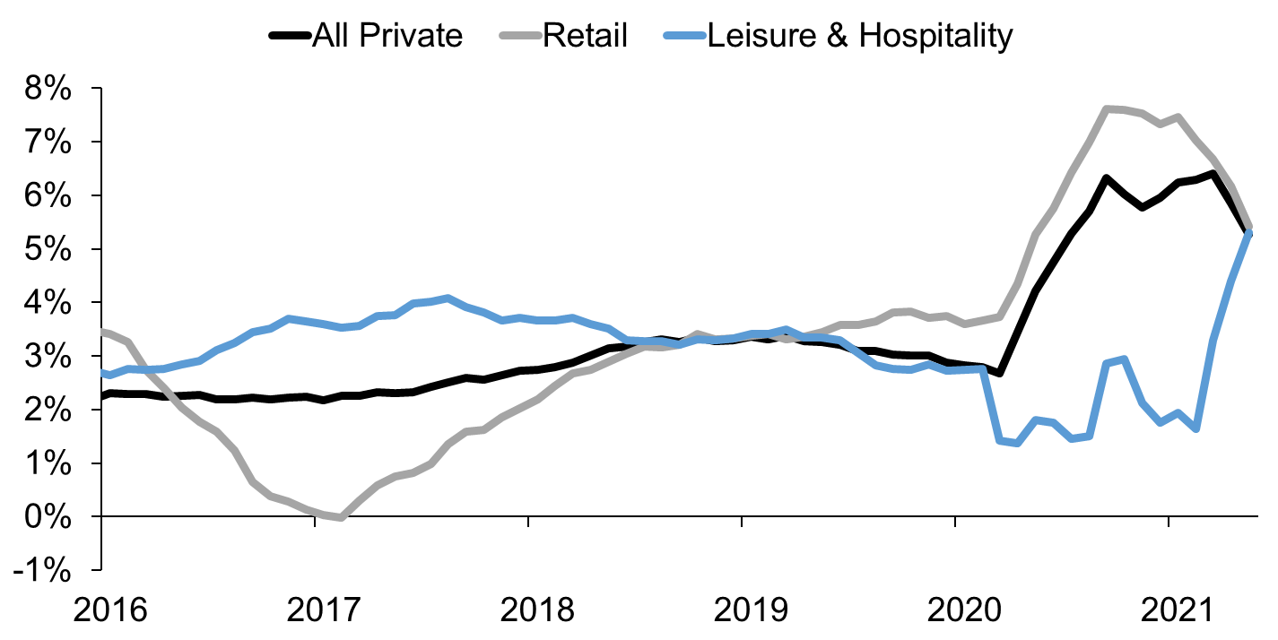
Wage Growth is Accelerating Annual Growth of Average Weekly Wages
Source: US Bureau of Labor Statistics

Slide 11
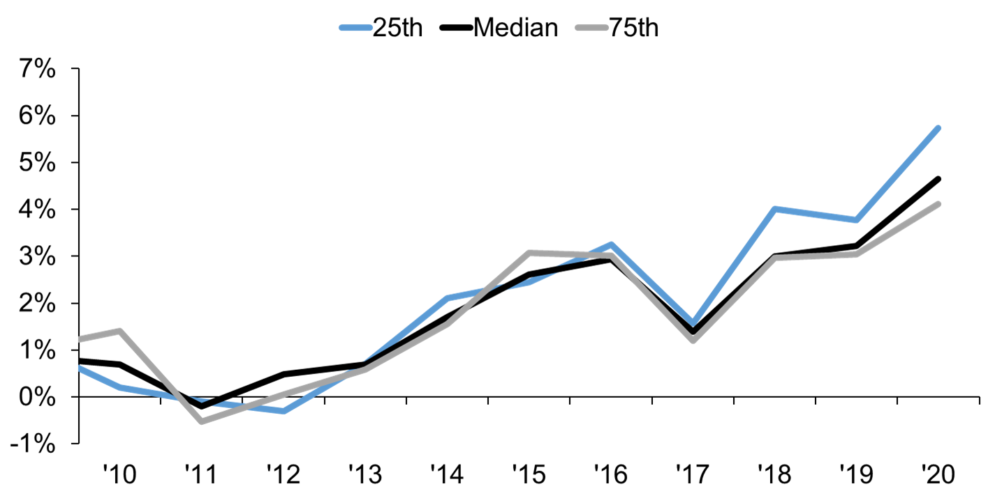
Wage Growth for Lower Wage Workers Annual Change in Hourly Wage by Percentile
Source: Idaho Department of Labor

Slide 12
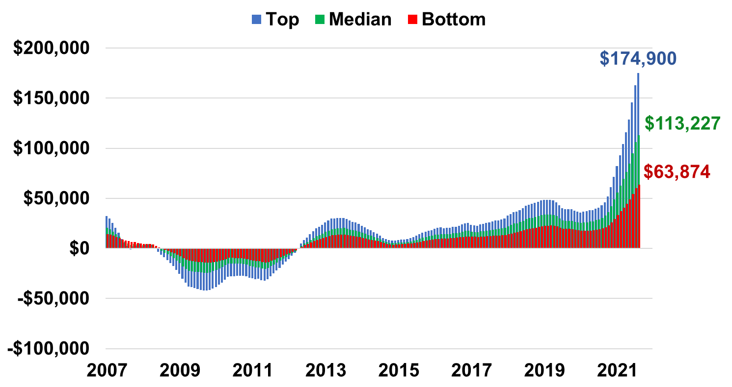
Idaho Home Values Annual Appreciation by Month to most recent, Aug 2021
Source: Idaho Department of Labor, Zillow

Slide 13
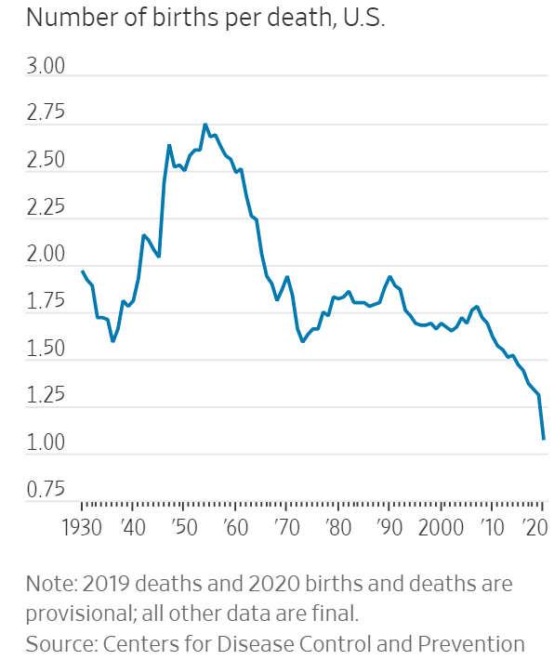
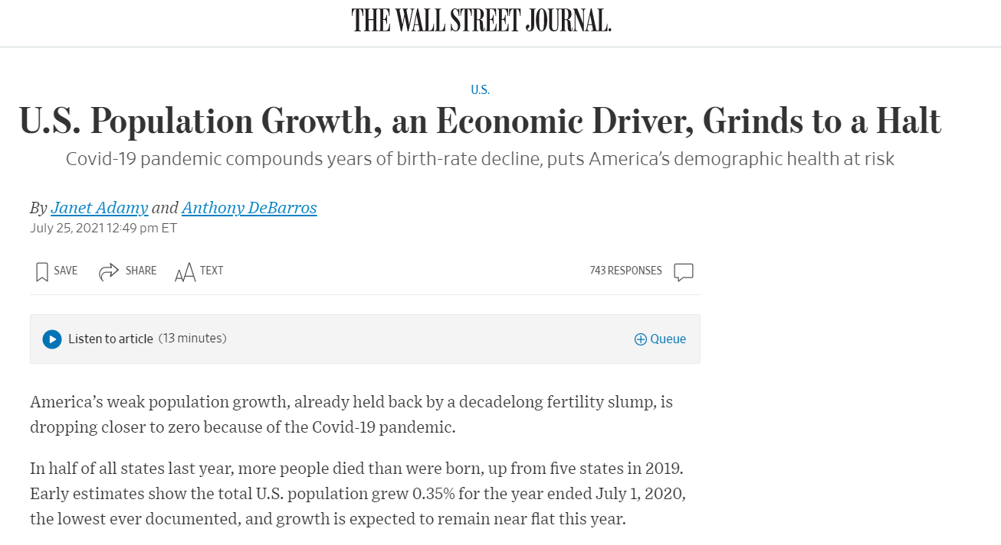
The Population Outlook
Source: Wall Street Journal

Slide 14
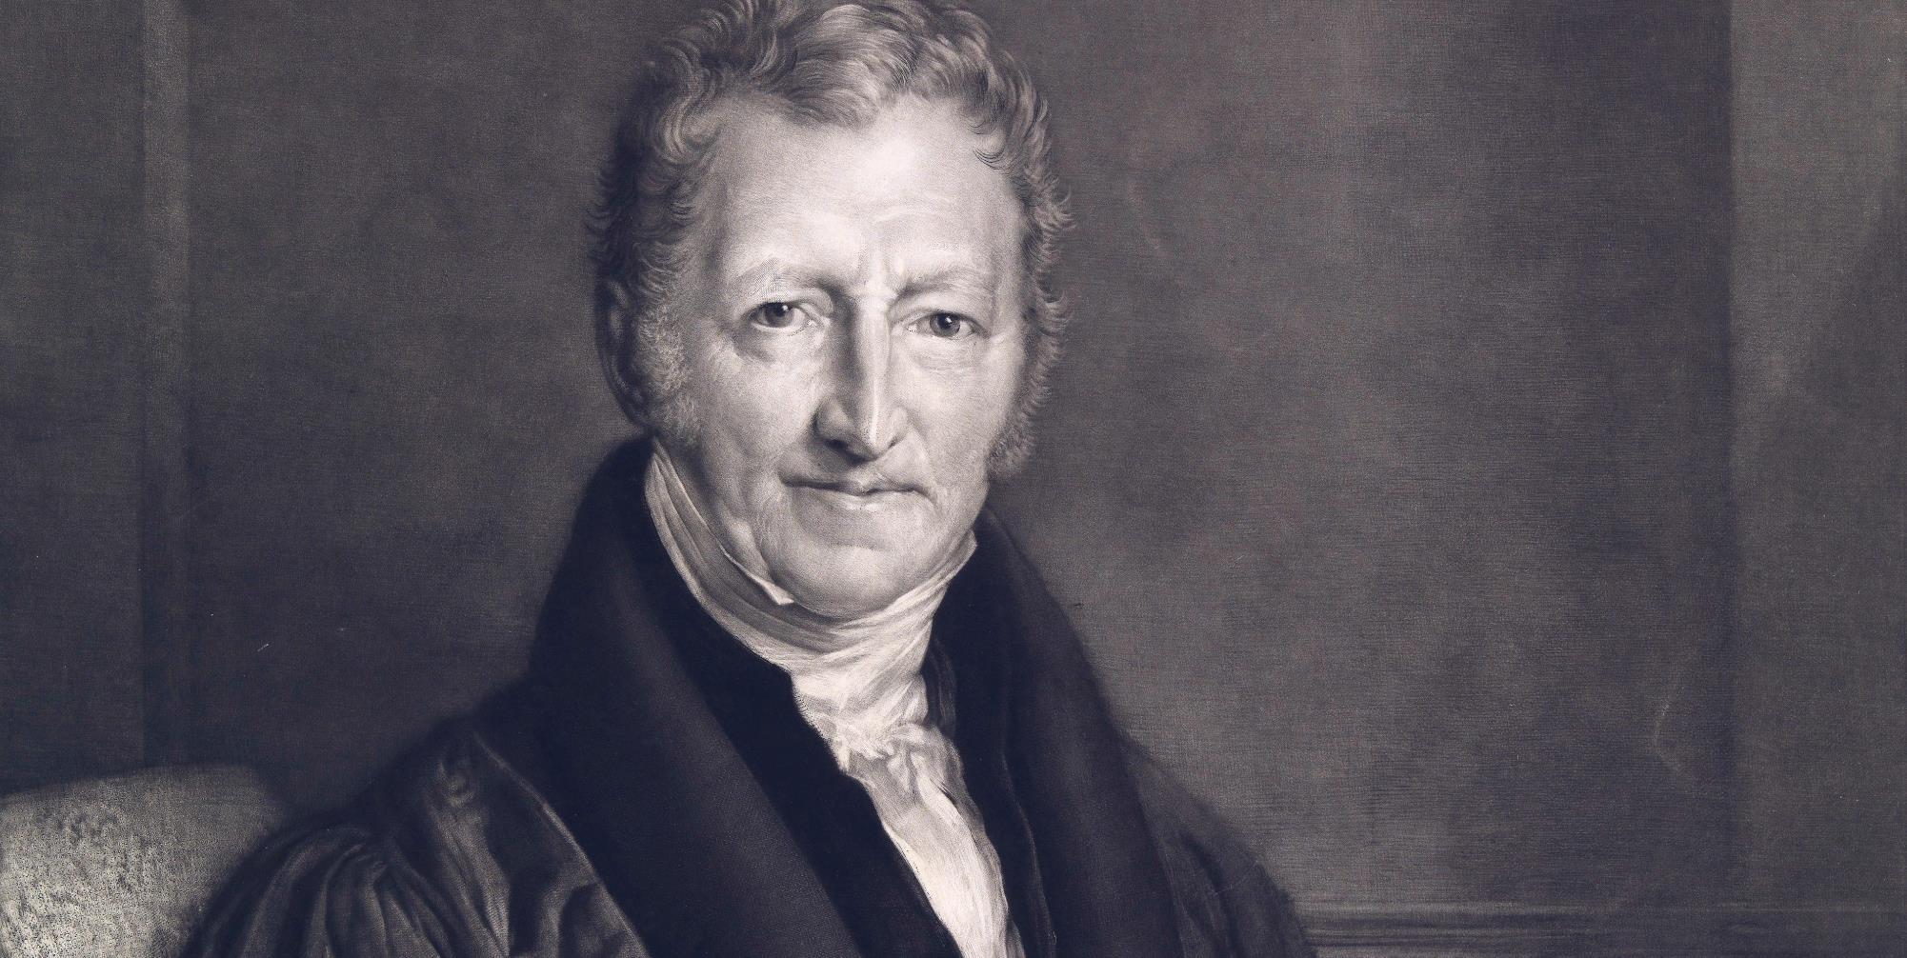
Reverend Thomas Robert Malthus, 1766 - 1834

Slide 16
Thank you. Craig Shaul Research Analyst, Supervisor craig.shaul@labor.Idaho.gov Labor Market Data and Economist Contacts: lmi.idaho.gov/region

Slide 17
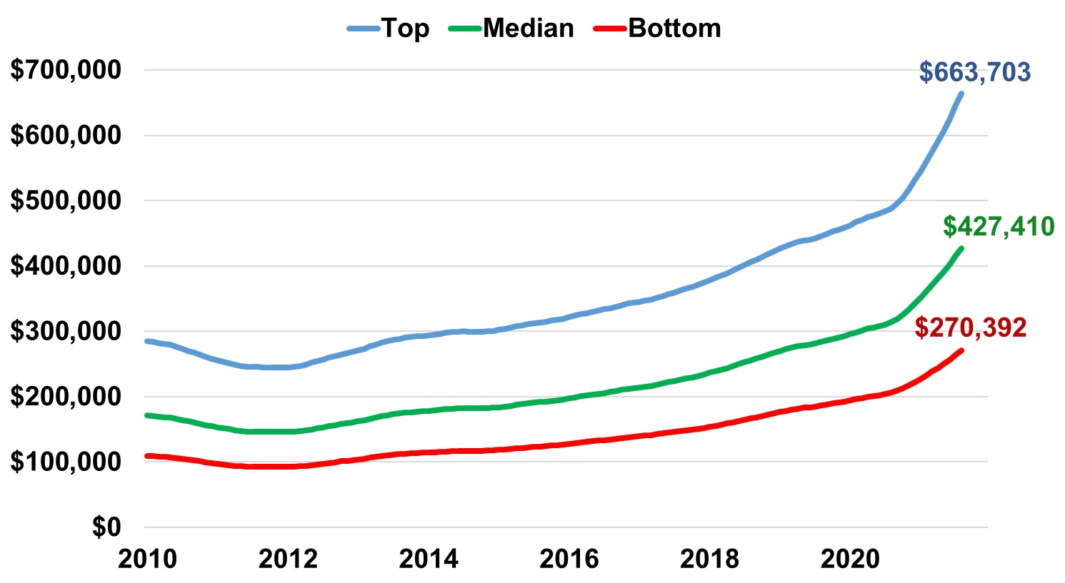
Idaho Home Values 2010 to most recent, Aug. 2021
Source: Idaho Department of Labor, Zillow

