Slide 1
The Extent of Governmental Power in Controlling a Pandemic
DHR Winter Forum
November 17, 2020

Slide 2
Disclaimer
The COVID-19 Pandemic is an evolving issue that has numerous legal issues that are fact-specific to moment(s) in time. If you receive a question related to COVID-19 and the law, it is recommended that you review the most recent guidance.

Slide 3
Who has authority during an emergency?
Federal Government
Governor
State Legislature
Director of Health and Welfare
State Health Districts
Counties
Local Government

Slide 4
Federal Government Actions
The Secretary of Health and Human Services declared a public health emergency on January 31, 2020;
On March 11, 2020, the World Health Organization declared COVID-19 a pandemic;
On March 13, 2020, the President declared a national emergency.

Slide 5
Idaho’s Timeline
On March 4, 2020, Governor formed a task force to address COVID-19 preparation in Idaho;
On March 13, 2020, the Governor issued the first emergency declaration;
On March 16, 2020, Idaho’s two largest school districts closed;
On March 25, 2020, the Governor issued an extreme emergency declaration and Idaho’s Stay Home Order;

Slide 6
Idaho’s Timeline Continues
On April 2 and April 15, 2020, the extreme emergency declaration was renewed and the Stay Home Order extended;
From May 1, 2020-June 13, 2020, Idaho entered Stages 1-4 of the Stay Health Order;
On July 4, 2020, Boise City issued a mandatory mask mandate;
On July 14, 2020, Ada County issued a mandatory mask mandate;

Slide 7
Idaho’s Timeline Continues
On October 27, 2020, Idaho reverted to Stage 3 of the Stay Healthy Order;
On November 13, 2020, Idaho reverted to Stage 2 of the Stay Healthy Order;

Slide 8
Governor’s Authority
Idaho Constitution
Title 46 (Militia and Military Affairs)
Chapter 10 – Emergency
Chapter 6 – Extreme Emergency

Slide 9
Difference Between “Emergency” and “Extreme Emergency”
“Emergency”
I.C. § 46-1002
“Emergency” is the occurrence or imminent threat of a disaster or condition threatening life or property that requires state emergency assistance to supplement the local efforts to save lives and protect property or to avert or lessen the threat of a disaster.
“Disaster” is the occurrence or imminent threat of widespread or severe damage, injury, or loss of life or property resulting from any natural or man-made cause, including but not limited to fire, flood, earthquake, windstorm, wave action, volcanic activity, explosion, riot, or hostile military or paramilitary action and including acts of terrorism.
“Extreme Emergency”
I.C. § 46-601
The existence of conditions of extreme peril to the safety of persons and property within the state, or any part therefore, caused by such conditions as . . . epidemic . . .

Slide 10
Emergency Authority
Majority of Governor’s authority during an emergency is within I.C. § 46-1008
Assume command militia and of all other forces available for emergency duty
Activate emergency response plans – State and local
Utilize all necessary resources of the state to pay for the disaster
Govern state agency response to the emergency however s/he deems fit
Utilize private property to respond to the emergency
Evacuate disaster areas; control ingress and egress
Control/limit sale of alcohol, combustibles, and explosives
Make provision for temporary housing

Slide 11
Emergency Authority
If Federally declared, Governor can:
Enter into agreements with Federal Government to help pay for disaster
Obligate State to pay for its share of the disaster
Enter into agreements with other states to respond to disaster

Slide 12
Examples of “Normal” Emergency

Slide 13
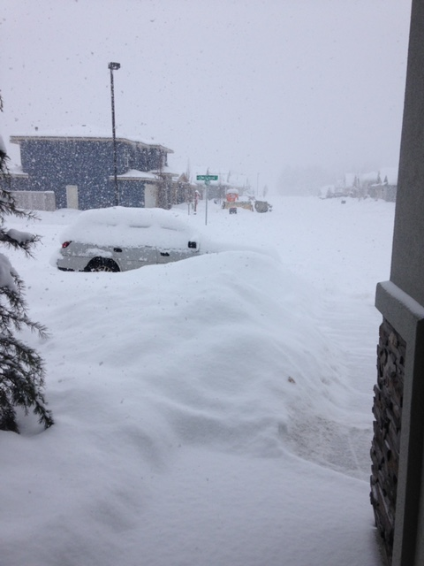
Examples of “Normal” Emergency

Slide 14
Extreme Emergency Authority
I.C. § 46-601
Activate National Guard
Complete authority over all State Agencies
Promulgate, issue, and enforce rules/regulations
Right to exercise all police power over the State
Declare martial law

Slide 15
Examples of Extreme Emergency

Slide 16
Examples of Extreme Emergency

Slide 17
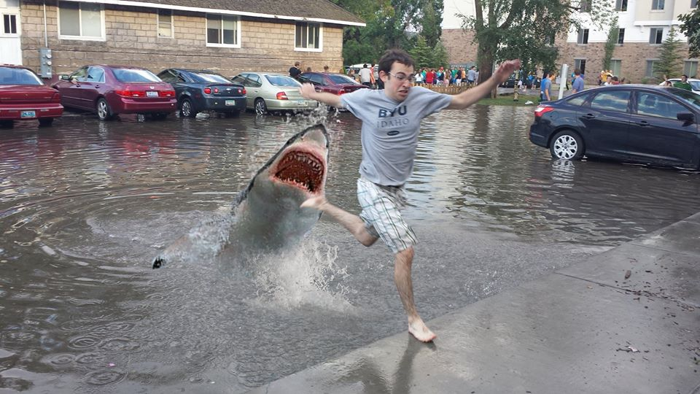
Examples of Extreme Emergency

Slide 18
Limitation on Governor’s Authority
During an Emergency and Extreme Emergency
CANNOT
Place restrictions on lawful possession, transfer, sale, transport, storage, display, or use of firearms

Slide 19
Extreme Emergency versus Emergency
Can the Governor….?
Close Borders?
Modify voting?
Isolated and order quarantine?
Compel non-essential business closures?
Mandate continued operation of essential businesses?
Commandeer/utilize private property?
Order martial law?

Slide 20
When Does the Emergency End?
Emergency
Declaration of the Governor
Need to be extended every 30 days or expires naturally
Extreme Emergency
Only at the declaration of the Governor

Slide 21
State Legislature
Regular session
Legislature sets the scope of the session to address any issues
Legislature can end an emergency by concurrent resolution
Special session
Only the Governor can call the legislature into a special session
Governor declares the scope of the special session
Idaho Constitution, Art. IV, Section 9
In other words, if called into a special session, only if within the scope can the Legislature end an emergency declaration

Slide 22
Director of Health and Welfare and Public Health Districts
I.C. § 56-1003(7) authorizes the Director of Health and Welfare to issue an isolation order, including the authority to make violation of the order a misdemeanor.
I.C. § 39-415 authorizes the same authority as the Director of Health and Welfare.
I.C. § 67-5247 authorizes the Health Districts to issue an emergency order to address the immediate danger to the public health, safety, and welfare of the people of the health district that requires the imposition of restrictions.

Slide 23
Idaho Public Health Districts versus Idaho Judicial Districts

Slide 24
Counties
Board of County Commissioners can declare a local disaster or emergency. I.C. § 46-1011
Allows the County to activate intergovernmental disaster emergency plan to furnish aid and assistance
Allows the county to demand immediate expenditures of public money in the public interest and where necessary without utilizing bidding procedures

Slide 25
Counties and Indigent Expenses
Title 31, Chapter 35 relates to the County payment of indigent resident medical expenses
Loan to the resident that attaches a lien on assets subject to repayment
Title 31, Chapter 34 relates to the County payment of indigent resident’s other expenses, including “shelter”

Slide 26
Local Government
Cities
Idaho Constitution Article XII, Section 2 says municipal corporations may “enforce, within its limits, all such local policy, sanitary and other regulations as are not in conflict with its charter or with the general laws.”
Title 50, Chapter 3 provides that municipal corporations may regulate public health, including the authority to quarantine to “prevent the introduction of contagious diseases into the city[.]” I.C. § 50-304.

Slide 27
Mayoral Authority
I.C. § 50-602 grants the Mayor of a municipal corporation “superintending control” of the affairs of the municipality.
I.C. § 50-606 grant the Mayor the authority to enforce “any health or quarantine ordinance and regulation . . .”

